Slide 1

Telecom Churn Prediction
Akos Redey
Mini project Applied Machine Learning Propulsion Academy, 7 May 2021

Slide 2
Problem definition
DATA
Task
Solution
Telecom Churn Prediction Dataset, with categorical variables describing the customer base and the services used and numerical variables with service time (tenure) and Service fees paid
Source: Kaggle
Describe the dataset and the relationships between Churn and customer Attributes (Categorical and numerical)
predict which customers will likely be cancelling their subscription and change to a new telecom provider
Exploratory Data Analysis and visualizing the relationships between target variable and features
Use Machine Learning Models for Classifying the Customers (Likely to Churn or Not Churn) and predicting the service disruption

Slide 3
Workflow
Business& Data Understanding
Deployment
#2*: Data Load & Basic Checks (N/As, zeros, datatype, info, describe the dataset)
#4: EDA (after Cleansing before Transformations – check relationships between target and predictors, visualize distributions)
Data Preparation
Pre-Deployment: Prepare the ML-App structure and use git Version Control throughout the process
Actual Model Deployment can be an extension of the Project
#3: Imputations and Data Cleansing (select categorical and numerical variables; perform basic transformations)
#5: Data Pre-processing (Train-Test Split, setup data imputers and one-hot-encoders for categorical and imputers and scalers for numerical features with sckit-learn -> apply it on the training and test set)
Evaluation
#8: Compare Model Performance (select the 2-3 best performing models and compare their predictions)
#9: Select Final Model (select final model and store its artifacts)
#10: Model Interpretation using SHAP and LIME
#11: Predict and Draw Conclusions (load back the dataset and the model artifacts; perform the necessary transformations, apply the pre-processing and finally load the model to make predictions, show the classification report and confusion matrix)
#12: Try Auto ML Model recommendation (as a check)
Modeling
#6: Build Base Models (spot check several models, visualize their overall performance, test hypothesis – pairwise p/t-test and ANOVA on model performance: null hypothesis -> the performances differ significantly )
#7: Hyperparameter Tuning (select the models with the highest initial performance, define a parameter grid for each model and perform randomized search, show the performances in a table)
* The numbers represent the numbered steps (sections) in the Jupyter Notebook

Slide 4

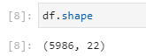
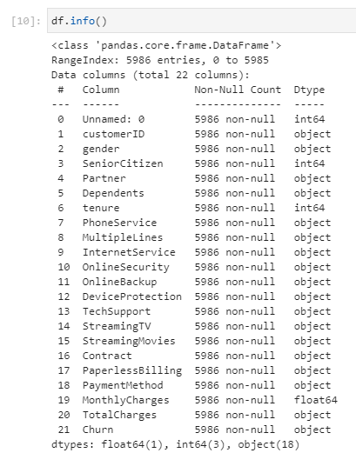
Dataset
Facts:
Dataset has 5986 rows and 22 columns
Numerical columns: Unnamed: 0, SeniorCitizen, tenure and MonthlyCharges
There are no missing values (NAs)
There are 5020 rows where the observation for senior citizen is 0 and 10 rows, where tenure is 0
There are no duplicate observations, the customerIDs are all unique
Need for correction:
Column “Unnamed: 0” has to be dropped as this looks like and ID
Column SeniorCitizen should be categorical and relabelled (0 to ‘Yes’; 1 to ‘No’)
Total charges should be numerical too (float), but we have some empty observations, due to the fact that those are customers, which are subscribers for less than 1 month, therefore they have tenure = 0 too - > assumption: it makes no difference if a customer is for one month or less than one month a subscriber, so we can make total charges equal to monthly charges in those cases (#10 observations) and tenure to 1
After making the base conversions we have 3 numerical (tenure, MonthlyCharges and TotalCharges) and 18 categorical variables

Slide 5

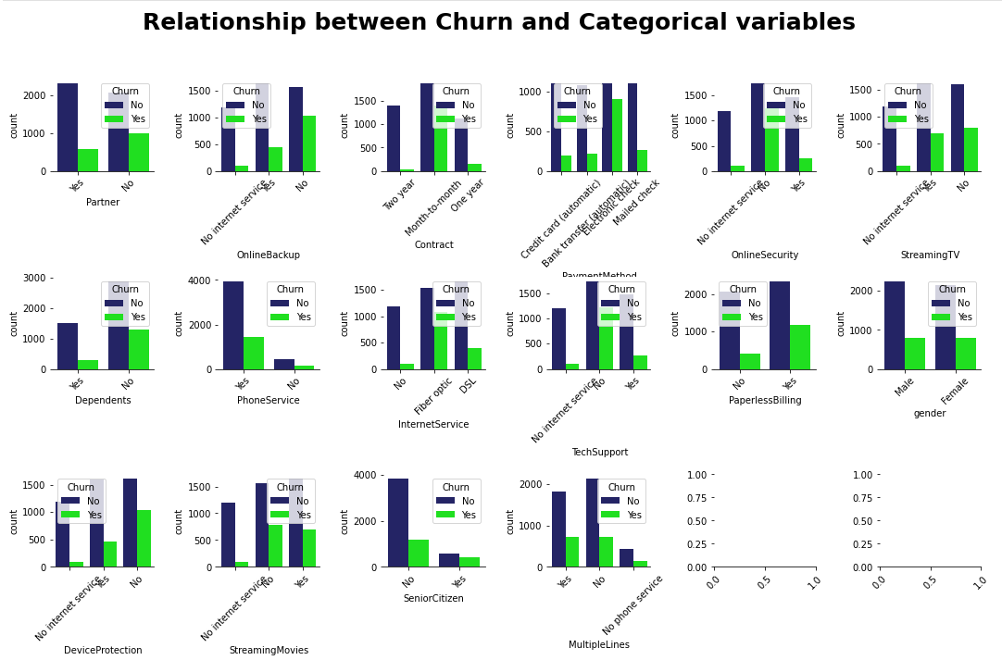
Exploratory Data Analysis (EDA) 1/2
Relationship between Churn and categorical variables:
Customers were more likely not prolonging the service, which:
had rather short time commitments (monthly contract)
had no tech support
had phone service
had fiber optic internet
had no online backup and had no online security
had no dependents
were rather younger customers
Other than that we cannot really say that male or female customers would rather churn

Slide 6
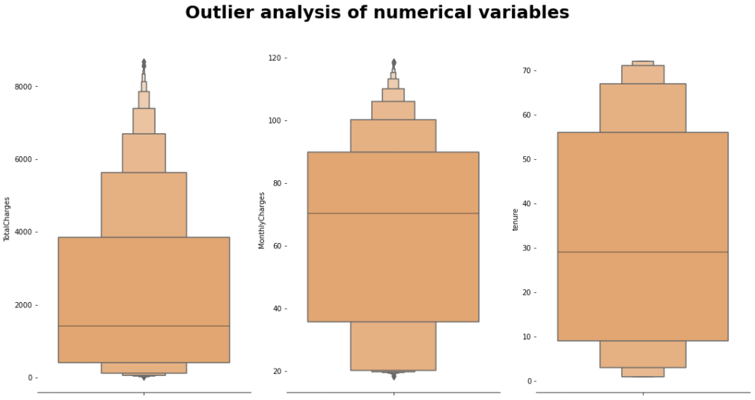
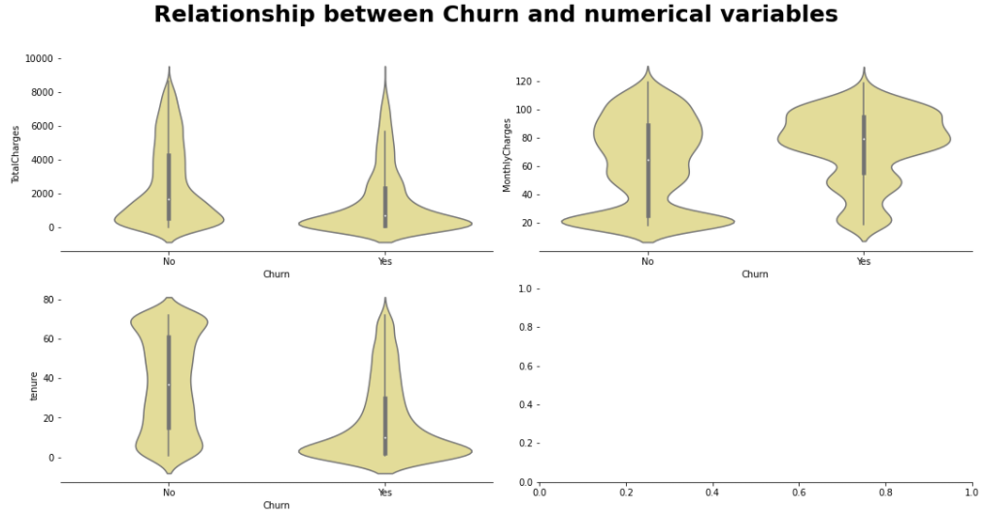
Exploratory Data Analysis (EDA) 2/2
Outlier analysis of numerical variables:
Mean tenure is around 30 months and on both ends of the distribution we have some outliers with 70+ months and less than 10 months tenure
The mean monthly charges paid were between 60 and 80 USD / month with some fees paid less than 40 and more than 100 USD/ month
The mean of total charges paid was around 1800 USD and we had some customers who paid more than 6000 USD
Relationship between Churn and numerical variables:
Customers were more likely not prolonging the service, which were not long-time customers
Customers seem to be price-sensitive to running costs (monthly charges), those who paid more than 80 USD were more likely cancelling the service
As a result of the above it seems to be rather a consequence that customers with below average total charges were among those who churned

Slide 7
Preprocessing
Train and Test Split
Split the Train Set to categorical and numerical features
Perform Imputations and One-Hot Encoding on the categorical features of the training set, using sckit-learn functions: Simple Imputer and One Hot Encoder
Remove Duplicate columns because of the On-Hot Encoding (several features have an observation “No Internet Service”, which information is already handled by the feature Internet Service, therefore these extra 6 columns have no added value to the model and can be dropped
The same is true for “Phone Service”, however there is only one extra column to be dropped
Perform Imputations and Scaling on the numerical features of the training set, using sckit-learn functions: KNN-Imputer and Standard Scaler
Check for 0s and N/As
Append the categorical and the numerical training set
Save the columns for the final dataset
Apply imputations, One-Hot Encoding and scaling on the test dataset
Append the categorical and numerical test set
Apply Label Encoding on the target variable as some algorithms (eg. XGB) require the target variable to be numerical

Slide 8

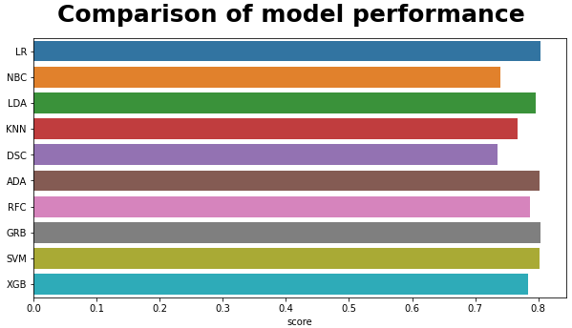
Modeling – Initial Model Building 1/4
Initial Spot-Check
Define some initial models (without defining any hyperparameters) and run a repeated stratified 10-fold cross validation, visualize the scores
The Models include:
(LR) Logistic Regression
(NBC) Naïve Bayes Classifier (Gaussian NB)
(LDA) Linear Discriminant Analysis
(KNN) K-Neighbors Classifier
(DSC) Decision Tree Classifier
(RFC) Random Forest Classifier
(ADA) Ada Boost Classifier
(GRB) Gradient Boosting Classifier
(SVM) Support Vector Machine model
(XGB) XG-Boost Classifier
5 models (LR, LDA, ADA, GRB, SVM) had the highest mean performance of 80% with differing St.Dev
We performed Hypothesis Tests and Hyperparameter Tuning on these models and selected the final model, saved it and used for prediction

Slide 9
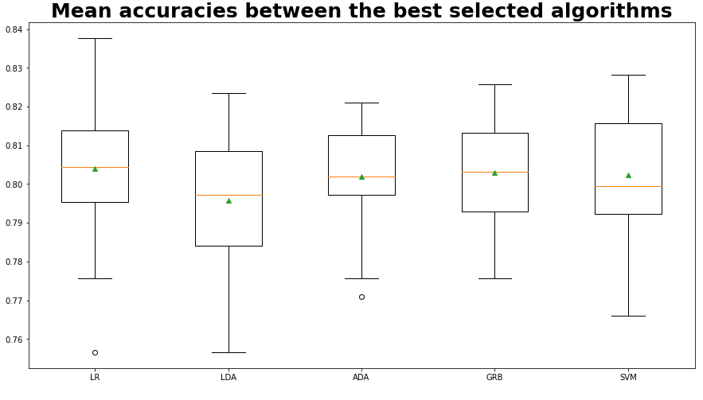
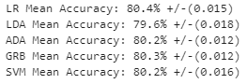
Modeling – Hypothesis Testing 2/4
Comparing the mean performances of the 5 models more precisely and visualising them on a Box-Plot we assume that the model performances are not that different
We can justify our assumption by performing pairwise p/t –Tests on each of the models
We also run a one-way ANOVA on all 5 models
Based on the Hypothesis tests we cannot reject the Null Hypothesis and conclude that the mean performances of the 5 models are not significantly different

Slide 10
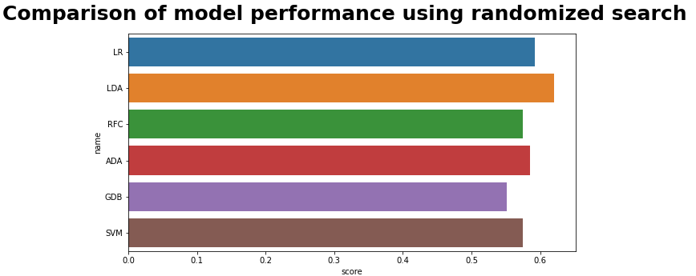
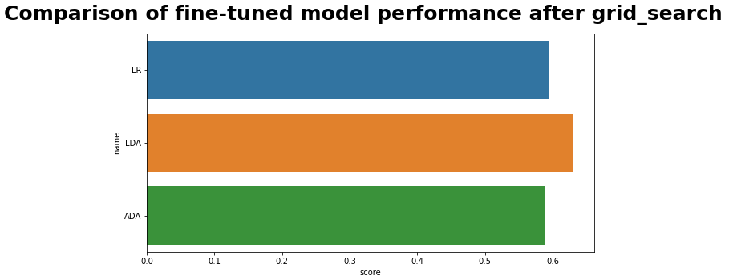
Modeling – Hyperparameter Tuning 3/4
Random Search
We performed a hyperparameter tuning with randomized search on all the 5 models with 80% mean performance, plus additionally on the next best performing Random Forest Classifier model (79% mean cross validation score)
Out of the 6 models, there are 3, which perform the best:
LDA: Linear Discriminant Analyst
LR: Logistic Regression
ADA: Ada Boost Classifier
For the above models we ran a grid search for fine-tuning the hyperparameters and for LDA and LR we could slightly improve the mean test scores
We compared the three models more closely, fit them and check their prediction performance

Slide 11
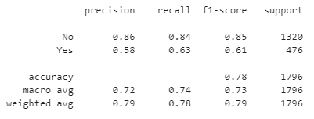
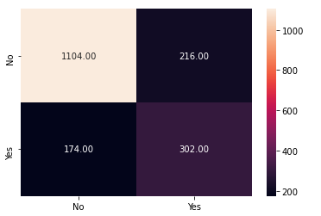
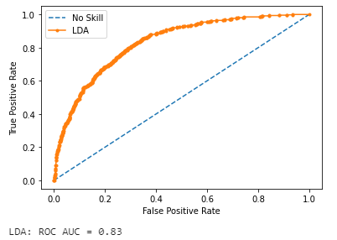
Modeling – Select Final Model 4/4
Comparison
We compared the prediction performance of the following models:
LDA: Linear Discriminant Analyst
LR: Logistic Regression
ADA: Ada Boost Classifier
Checking the classification report, we get comparable mean F1-scores (only ADA’s score is slightly lower) and ROC-curves, however if we compare the confusion matrices we can see that LDA has a better recall score and therefore it gives us a smaller false negative rate, which is important because we have less cases of churn which we predict as customers who stay and therefore slip under our radar; the other two algorithms had better False Positive scores
We selected Linear Discriminant Analysis as our final model with ‘least squares solution’ and shrinkage parameter of 0.5
LDA performed best as a simple algorithm, which not only can be used for dimensionality reduction, but for supervised classification

Slide 12
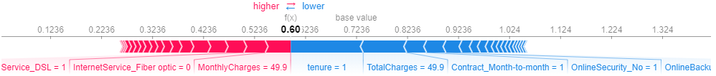
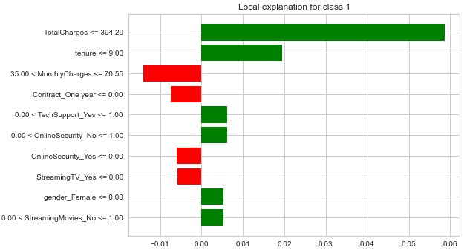
Interpretation
SHAP
LIME
We ran a model interpretation using the LDA predicted probabilities
The Model interpretation based on the Shapley values interpreted the monthly charges of 50USD as a positive and a tenure of 1 month as a negative factor for the probability
The Model interpretation using LIME gave us an even better insight, showing us that the tenure less than 9 months and the total charges less than 395 USD contributed to the prediction of the churn; whereas the monthly charges less than 70USD and the longer term contract contributed to predicting the customer to stay

Slide 13
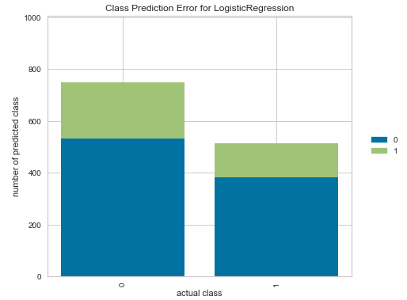
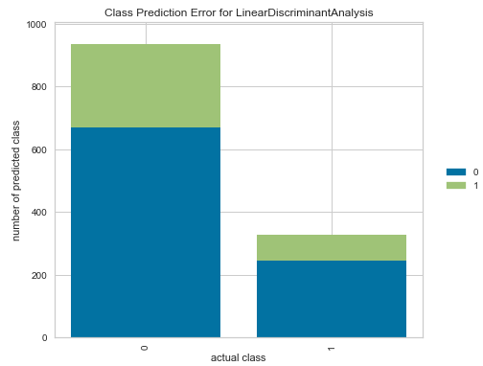
Auto ML Model recommendation
We ran an Auto ML experiment with Pycaret, as a check to see if our model considerations can be confirmed
The algorithm recommended three models with the highest accuracy score:
LR: Logsitic Regression, RIDGE: Ridge Classifier and LDA: Linear Discriminant Analysis
As we too had LR and LDA among the best performing models, we used Auto ML to tune these two models and give us more insights regarding the ROC Curve, Prediction Error, Classification Report and Feature Importance
The ROC-curve confirms, as the Classification Report too, that LDA has a better sensitivity rate, when it comes to false positives
LDA has a lower prediction error (see above), and less cases of missing to predict the churn; also when it comes to false positives, LDA performs better; however it also has a higher false negative rate
In the notebook we also included the Feature Importance graph, which shows that for LDA the most important feature is Monthly Charges, whereas for LR it is rather Dependents and Total Charges

Slide 14

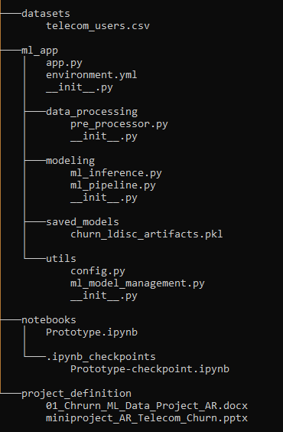
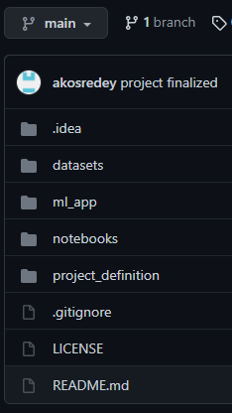
Automation, Version Control
Preparing for Automation:
As a preparation step for automation, we created the tree and file structure for automating the process and deploying an ML-app
Created the folders and python files for the app, modelling functions, pipelines and utilities
Created a folder for the model itself and saved the model artifacts and the model into the folder
Created a notebook folder and saved the prototype notebook there (main deliverable of the mini-project)
Created a folder for the project definition, where we stored the one-pager description of the mini-project as well as the slide deck as an explanation of the project steps and conclusions
Version Control with Git:
We created virtual environment (ml_telecom_churn) and an environment.yml file from which it can be cloned
Throughout the process we used git for version control and pushed the changes into the github-repository, where the tree structure of the project files is mirrored

